Slide 1
Git 101 Workshop
Notes:
Welcome to Git 101, Pankaj Intro, Ryan Intro

Slide 2


Introduction
Pankaj
Ryan

Slide 3


Tools
Text Editor:
VS Code
GitHub Desktop

Slide 4
Plan for the Workshop
What is Git?
What is GitHub?
Basic of Git and GitHub
Some advance features of GitHub
Hands-on practice
What to learn for the future?

Slide 5

What is Git?
Git essentially is a version-control system for tracking changes in a file/folder. It stores a complete history of the changes and allows you to revert any of these changes easily.

Slide 6
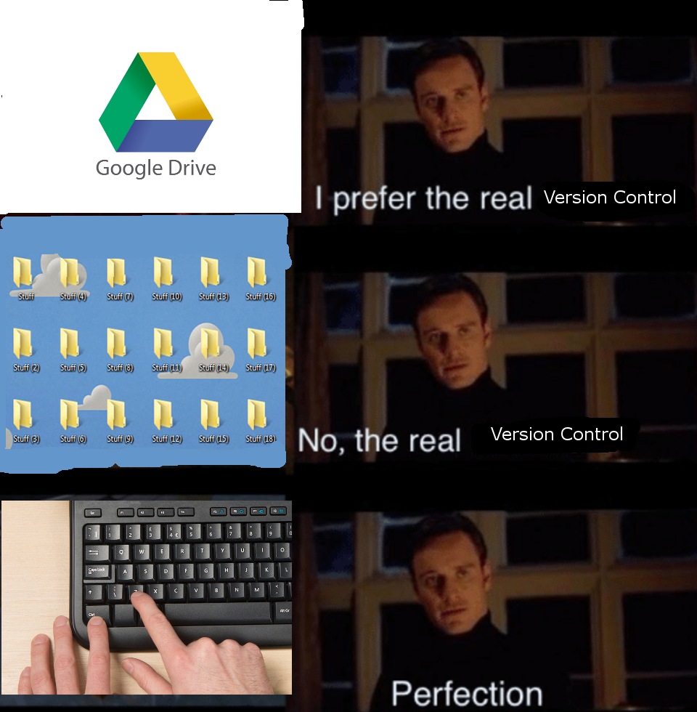
Version Control
Version control helps teams to track every individual change made by every contributor and helps prevent concurrent work from conflicting.

Slide 7

What is GitHub?
GitHub is a Git repository hosting service. It always you to share your work with other developers around the world or just within your team
It also has many of its own feature like fork, pull request, access control etc.

Slide 8
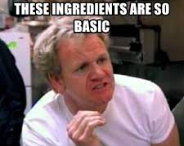
Basics of Git
Repository
Commit
Branch

Slide 9
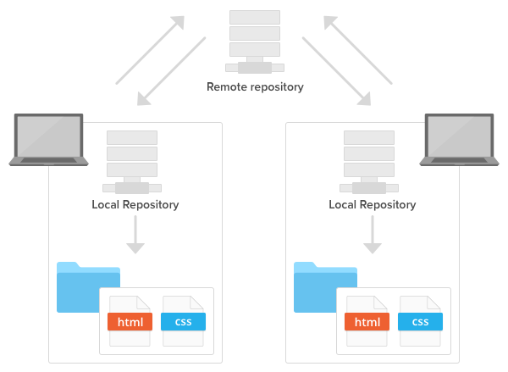
What is a Repository?
A repository is nothing but a storage location for your code base.
There are 2 kinds of repositories:
Local
Remote

Slide 10
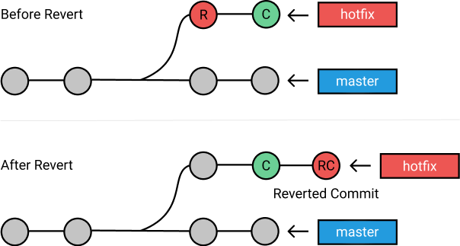
What is a Commit?
Commit is basically a snapshot of your code at that particular time. It is similar to saving your progress just like you save your progress in a game.
Added a new feature
Master branch
Initial Commit

Slide 11
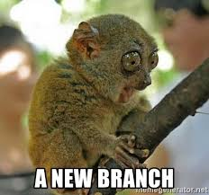
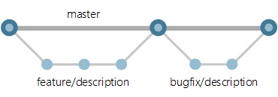
What is a Branch?

Slide 12

What is a Branch?

Slide 13
Basics of GitHub
What is Cloning?
What is git push and git pull?
What is a fork?

Slide 14
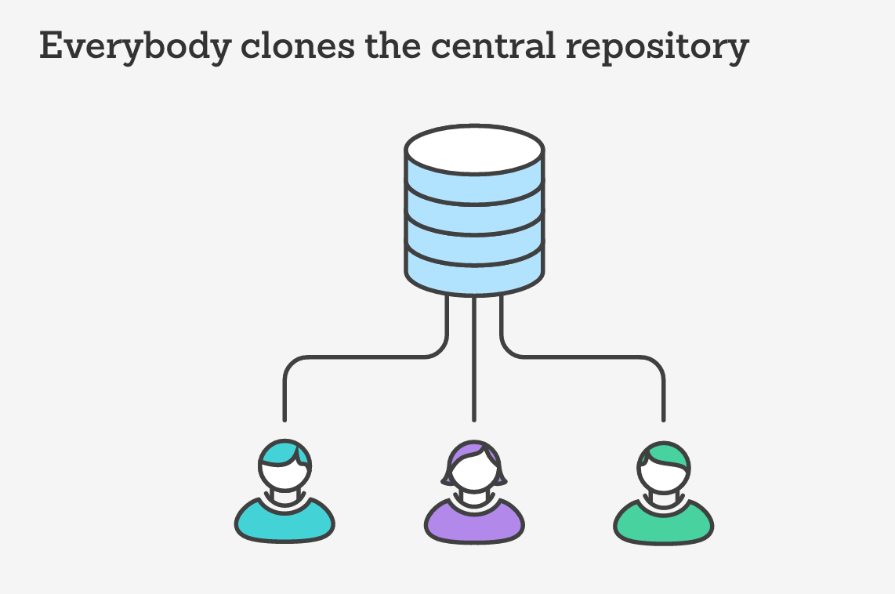
What is Cloning?
Cloning a Repository essentially means downloading a copy of the remote repository to your computer

Slide 15
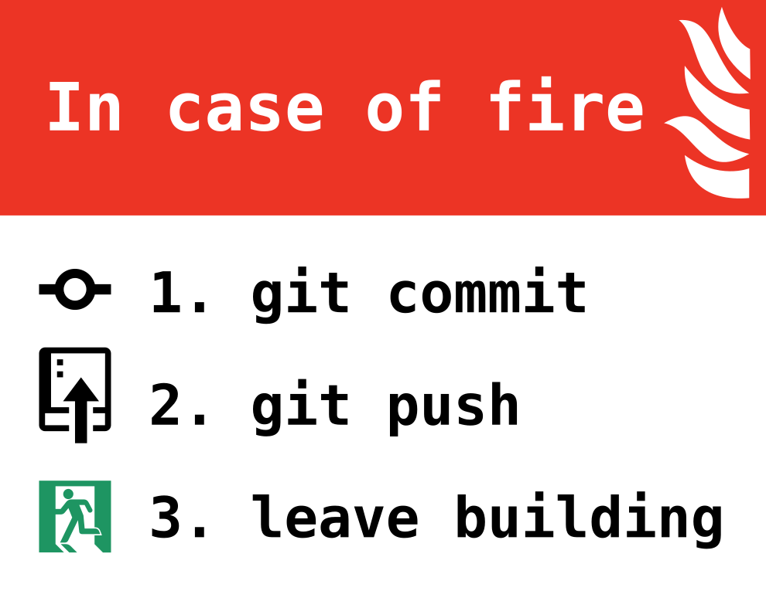
What is Git push?
Uploading your commits/changes from your local repo to the remote repo

Slide 16
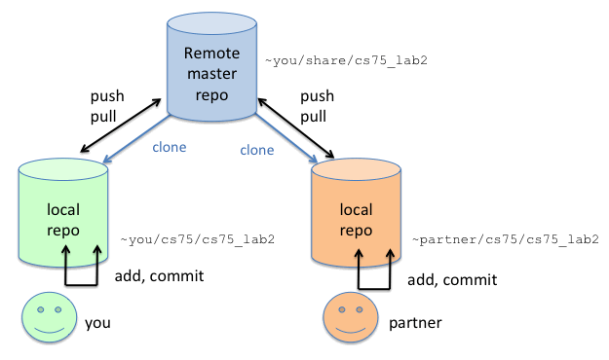
What is Git pull?
Downloading the commits/changes from the remote repo to you local repo

Slide 17
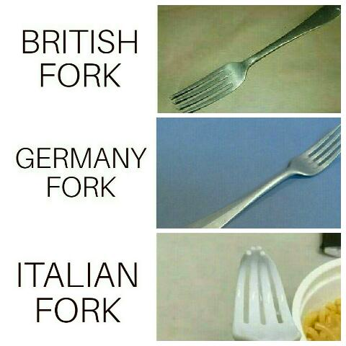
What is a fork?
A personal copy of another person’s repository is called a fork

Slide 18
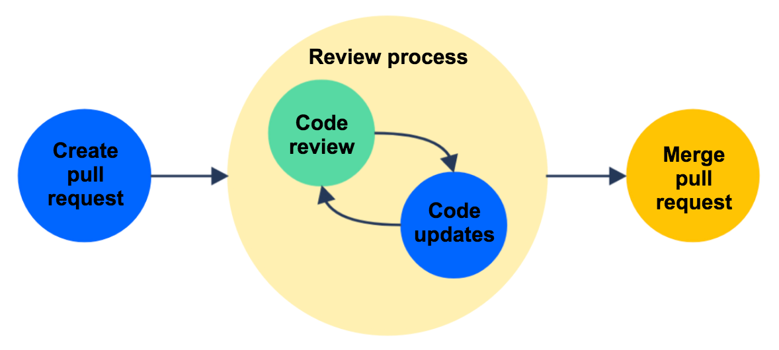
Advance feature: Pull Request
Pull request is a request that you send to someone to review the changes that you have made.
There are two types of pull requests:
Between two different branches
Between two different repos

Slide 19
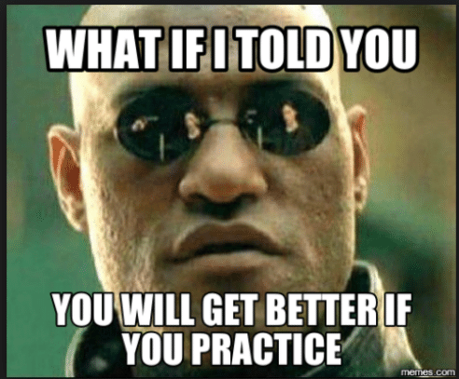
Time for some hands-on practice

Slide 20
Now for the harder stuff
Pull requests
Pull requests templates
Pushing upstream

Slide 21
Branching Techniques
Git feature flow
Git flow
Just smash it all in master

Slide 22
Git feature flow
Allows you to keep a clean master/release branch at all times
Allows you to collaborate without stepping on each others toes
Allows you to create branches to try things out
High benefit, to low difficulty ratio

Slide 23
What is a network graph?
Allows you to see a tree/history of your commits
Reads left to right on GitHub
Should make sense

Slide 24
Smash it all in master
Commit 1
Commit 2
Commit 3
Commit 4

Slide 25
Git feature flow (solo dev)
Release 1
Release 2
Commit 1
Commit 2
Commit 3
Commit 4

Slide 26
Git feature flow (team)
Release 1
Release 1
Release 1
Release 2
Release 3
Release 3
Release 4
A1
A2
A3
B1
B2
C1
C2

Slide 27
Merge Conflict
Unavoidable in working together
If you touch the same file, or breath the wrong direction

Slide 28
Merge Conflict

Slide 29
There can be a lot going on
Tools can help you!
Merge conflicts
Git pull request rules

Slide 30
Git feature flow (team)
Release 1
Release 1
Release 1
Release 2
Release 3
Release 3
Release 4
F1
F2
F3
B1
B2
F1
F2

Slide 31
PR template
A template makes sure you perform key actions in your pull request (when you make a release).
A very important step can be “Merge master into my branch before making pull request”.
Others like attaching trello cards

Slide 32
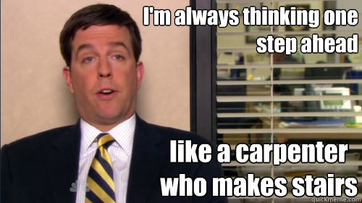
What else to learn?
CI / CD
Code review
GitHub Actions
Notes:
P
Make notes for this …….

Slide 33
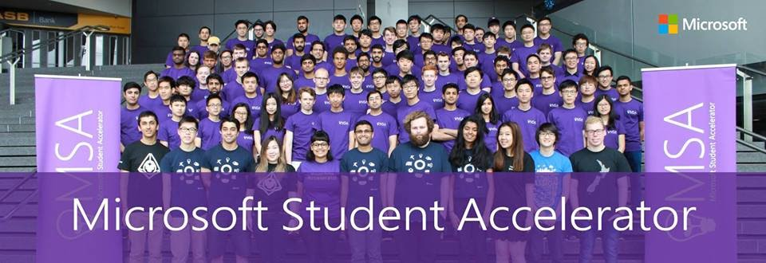
This will be you!
Notes:
Maybe in HD this year though. We will make sure it's at least 1080p

Slide 34
Questions?

